Slide 1
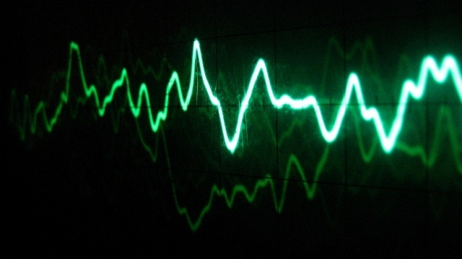
APPLIED SIGNAL PROCESSING LABORATORY
Paolo Allione s296500
Camolese Claudio s297378
Temmuz Sanli s298029

Slide 2
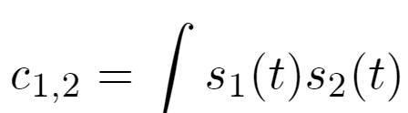
Detection of a signal
The goal of this assignment is to use correlation to detect the presence of an alarm signal generated by a sensor.
Correlation gives a measure of the similarity between two signals and is defined as:
Furthermore, the correlation value is in between 0 and 1.
The correlation is 1 when the two signals have the same shape and 0 if they are orthogonal.

Slide 3
Presence of a pulse inside a time window
Suppose to observe a time window which may or may not contain a pulse of a sensor. In both cases, thermal noise is present.
Two events have to be distinguish:
H₀ the window contains only noise;
H₁the window contains a noisy version of the pulse.
Correlations needs to be compute between the observed signal and the original sensor pulse. If this correlation si very high then the window contains the pulse, otherwise only noise.

Slide 4



False Alarm and Missed Detection
So, we denote as Γ our correlation test.
A threshold is set and if Γ$≥$ t the pulse is present (event H₁), otherwise the pulse is absent (event H₀).
Two scenarios are possible:
False alarm: the pulse is absent but due to noise the test is above the threshold. The probability of false alarm is
Missed detection: the pulse is present () but due to noise the test is below the threshold. The probability of missed detection is

Slide 5
Exercise
After creating a signal and fixing the SNR value, generate and plot a noise signal realization;
Generate num_{sim} noise realizations n(t), compute the normalized correlation test Γ for the observed signal under H₁ and under H₀ and plot the num_{sim} value of Γ under H₁ and under H₀ ;
Plot the pdfs of Γ under H₁ and under H₀ using histogram function;
Plot P_{fa} and P_{md} vs the threshold t;
Plot the ROC curve;
Repeat exercises using energy computed over time instead of the correlation.

Slide 6
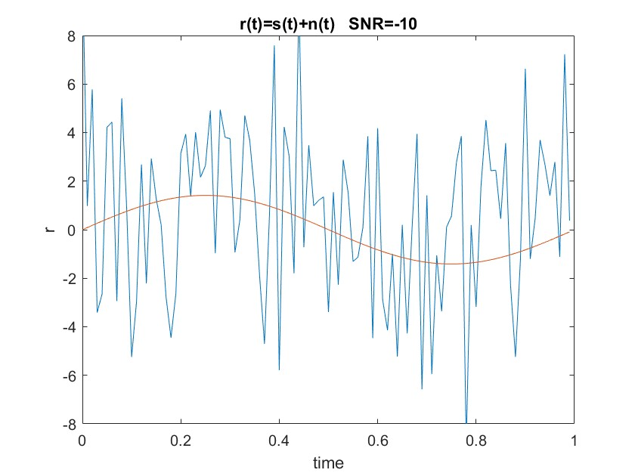

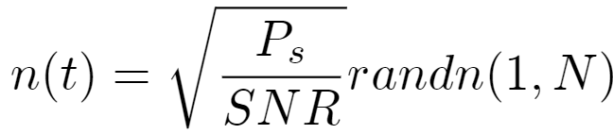


Signal plus noise
The sensor outputs generates a sinusoidal signal with f₁=1 Hz and an amplitude of $A=\sqrt{2}$ .
The signal is:
The noise is generated using:
We call:
the noisy signal.

Slide 7
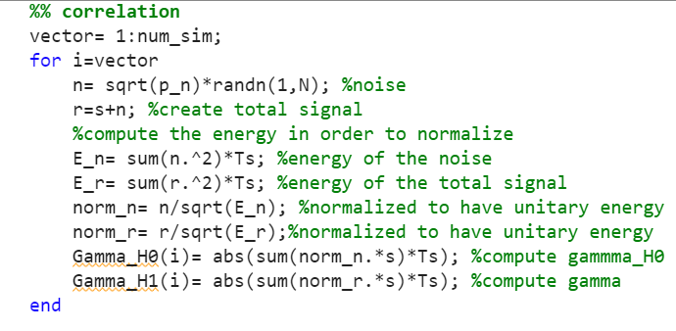
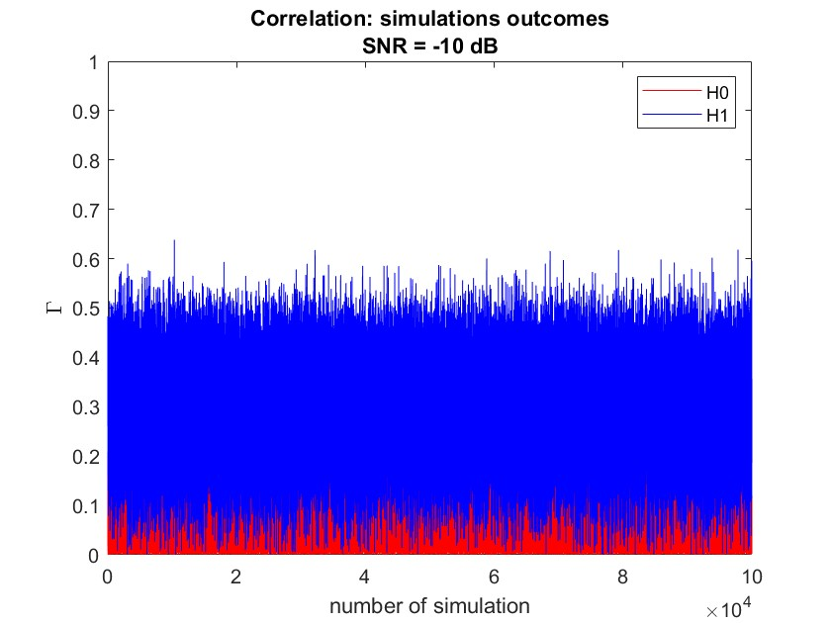
Correlation
This portion of the code generates a num_{sim} noise realizations n(t) and then, for both n(t) and r(t), the normalized correlations test Γ is computed.

Slide 8
Correlation: plot
Let’s analyze the plot in details:
H₁: is the event where the time window contains a noisy version of the pulse. Because in this case the signal sensor is present and we are computing correlation with the original signal, the H₁ values are higher;
H₀: is the event where the time window contains only noise. We are still computing the correlation with the original signal and due to the absence of the original signal, H₀ values are around zero.

Slide 9
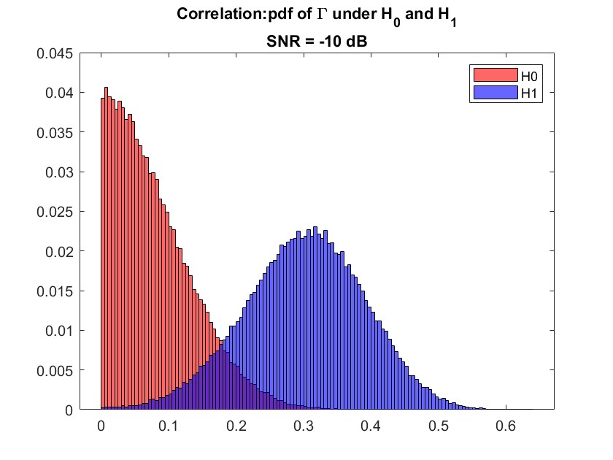
Correlation: histogram
The plot represents the histogram of the distribution of the correlation Γ under H₁ and under H₀.
H₁: due to the fact that the signal is present, the correlation is more similar to a normal gaussian;
H₀: due to the absence of the signal, the correlation has a peak on the zero value. This means a lower correlation, as expected.

Slide 10
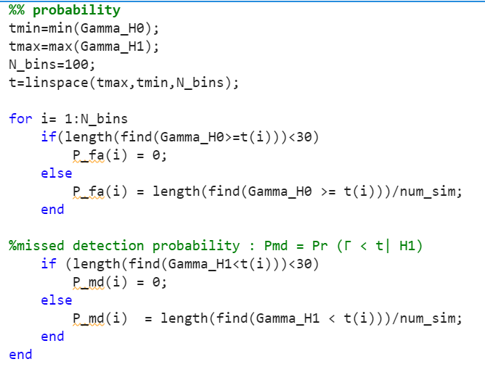
False Alarm and Missed Detection
To consider the probability of false alarm P_{fa} and the probability of missed detection P_{md} , we consider 100 threshold between the minimum and the maximum of Γ.
Then we compute
In order to have a good reliability of the measured probability, an if statement is implemented.

Slide 11
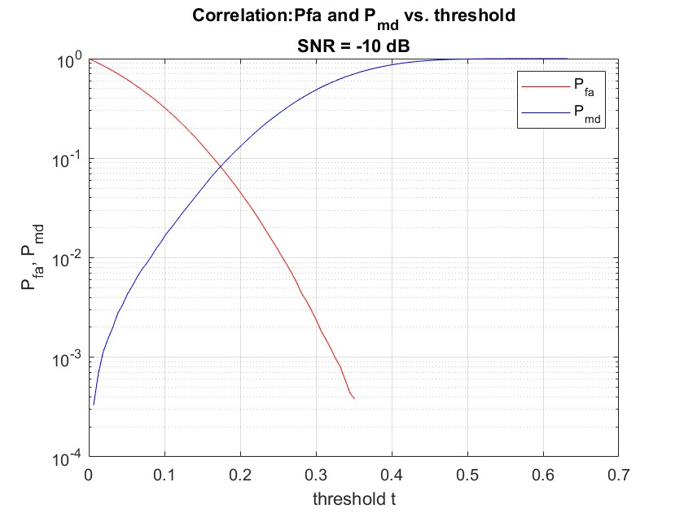
False Alarm and Missed Detection: output
The plot shows how these two probabilities change as the threshold varies. In particular, P_{fa} decreases as the threshold increases, while P_{md} increases.
This means that raising the threshold makes the detection more prone to missing real signals.
Furthermore, it reflects the fact that for lower values of t, pure noise may be detected and this condition increases false alarm.

Slide 12
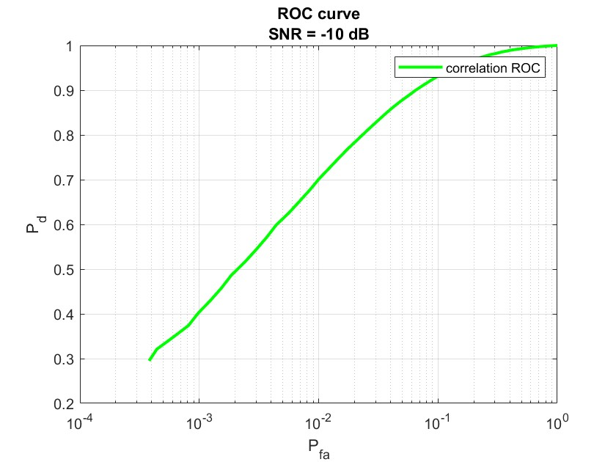

ROC curve
Defining the probability of correctly detecting the signal as:
we plot the ROC curve.
The ROC curve illustrates the diagnostic ability of a binary classifier system as its discrimination threshold is varied.
The closer this curve is to the top left corner, the better is the performance of the binary classifier.
Due to SNR=-10, we are far from ideality.

Slide 13
Example: SNR=-20dB
If we decrease the SNR value, the noise has an higher contribution on the signal, as consequence:
The resulting signal is very noisy;
Correlation is more overlapped, this increase the difficulty to detect the signal correctly;
ROC curve less closer to the top left corner and more close to zero. Then, there is a more reliable detection only for high false alarm.

Slide 14
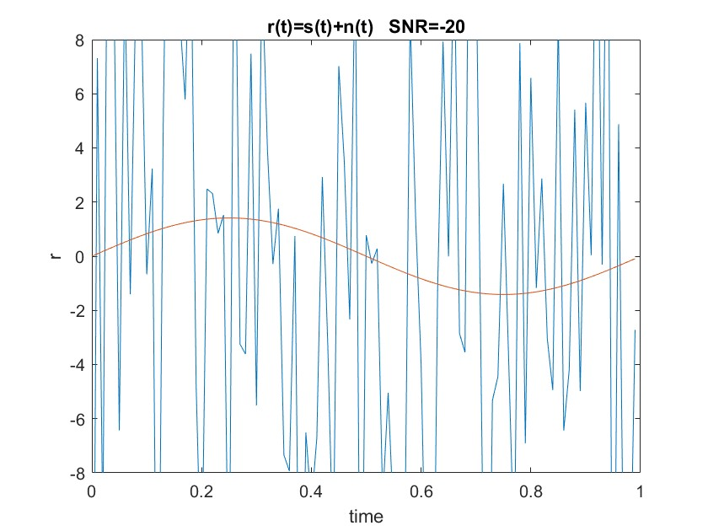
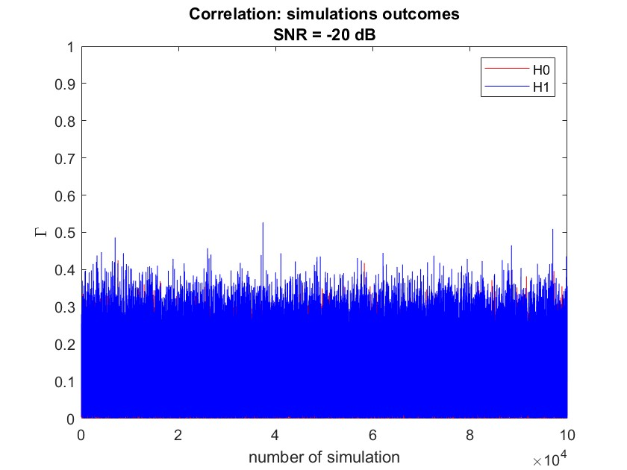
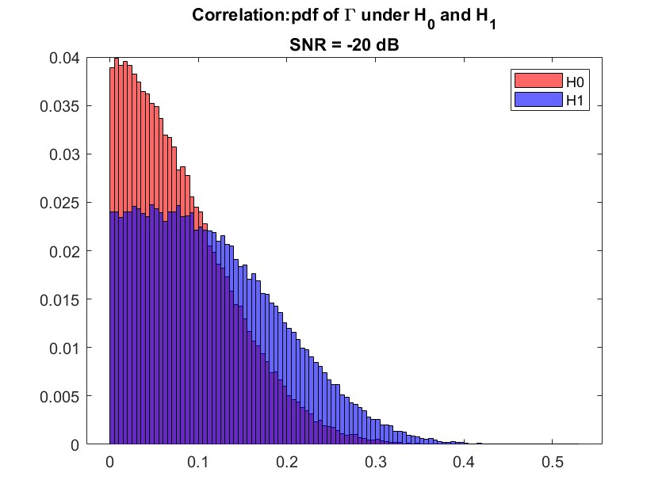
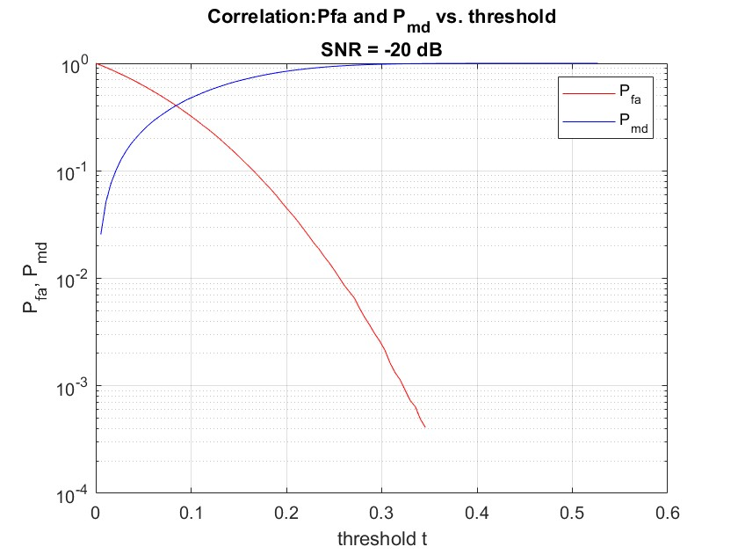
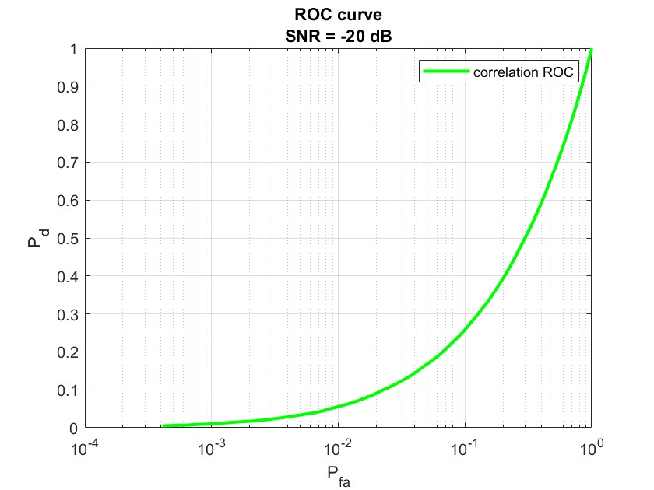
SNR=-20dB: outputs

Slide 15
SNR= 0dB
If we increase the SNR value, the noise has a lower contribute on the signal, as consequence:
Resulting signal is less conditioned by the noise. This produce a more easy detection;
False alarm and missed detection are no more overlapped. So, if we set the threshold between 0.4 and 0.5 it is possible to obtain a zero false alarm and missed detection probability;
ROC curve is equal to 1 and this means that the correct detection is always performed.

Slide 16
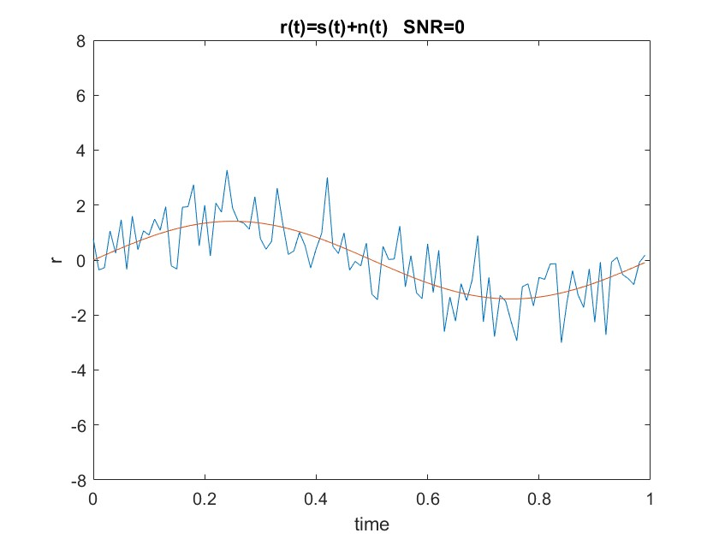
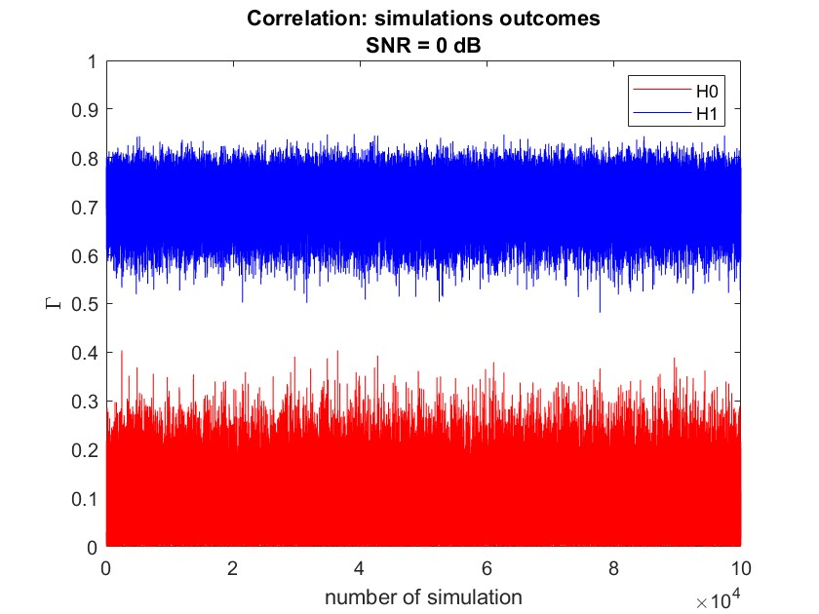
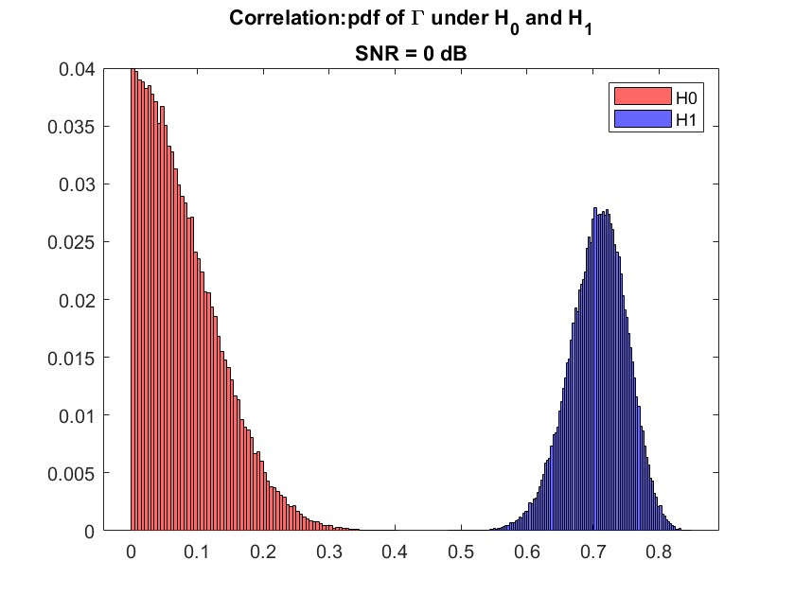
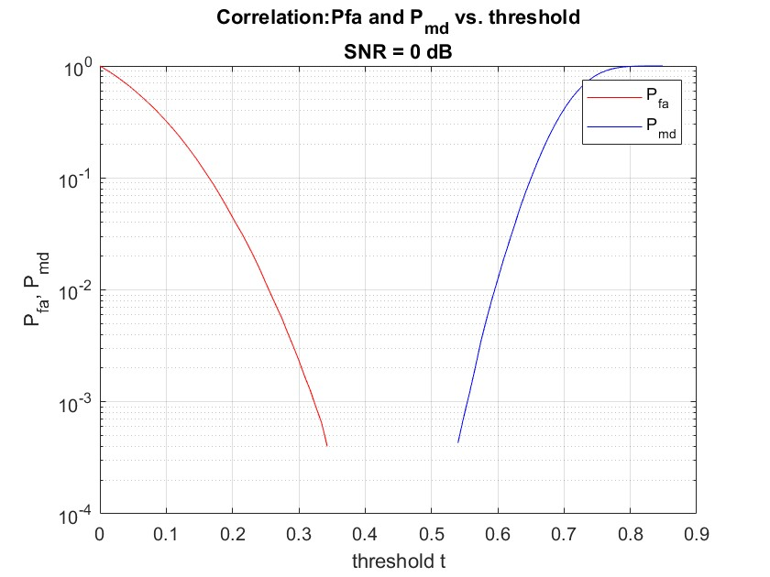
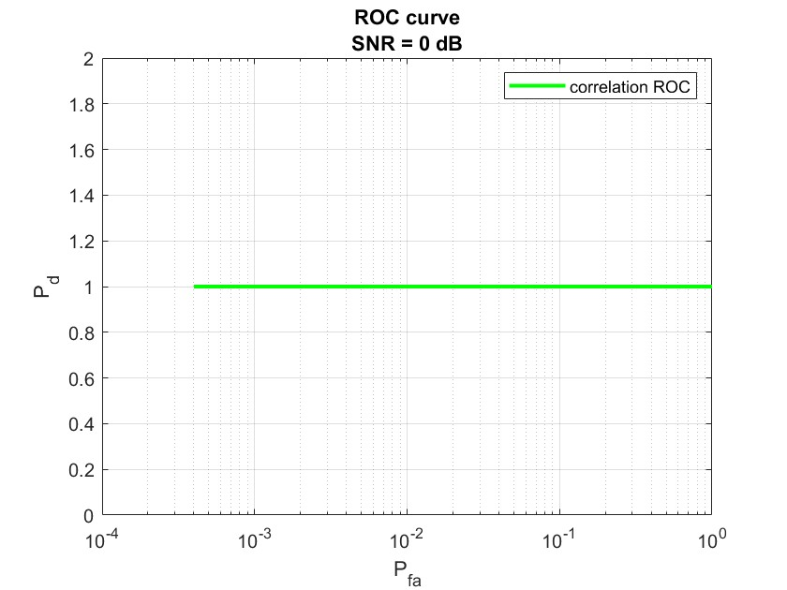
SNR=0dB: outputs

Slide 17
Energy instead of correlation
We repeated the entire exercise by using as statistical test Γ the energy computed over the time window instead of the correlation.
In order to do that, we did not normalize but instead used the energy of the total signal and the noise.

Slide 18
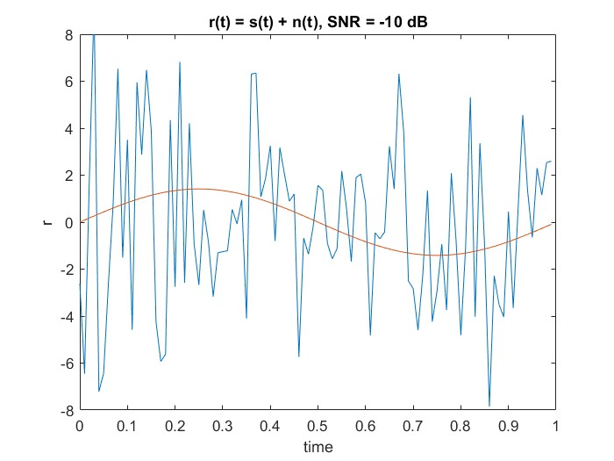
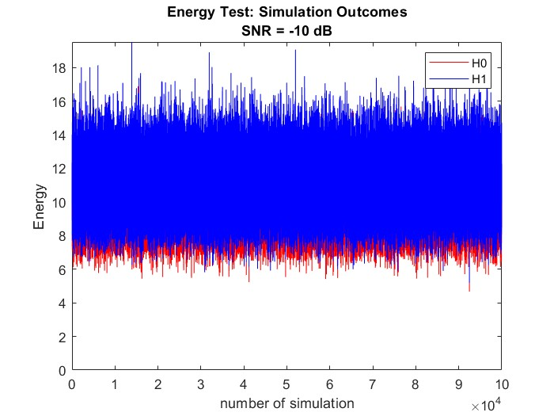
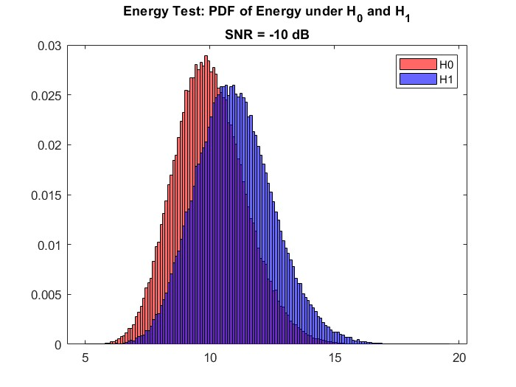
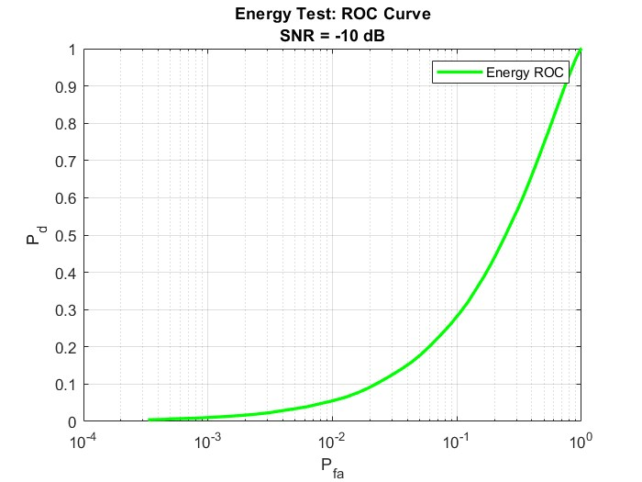
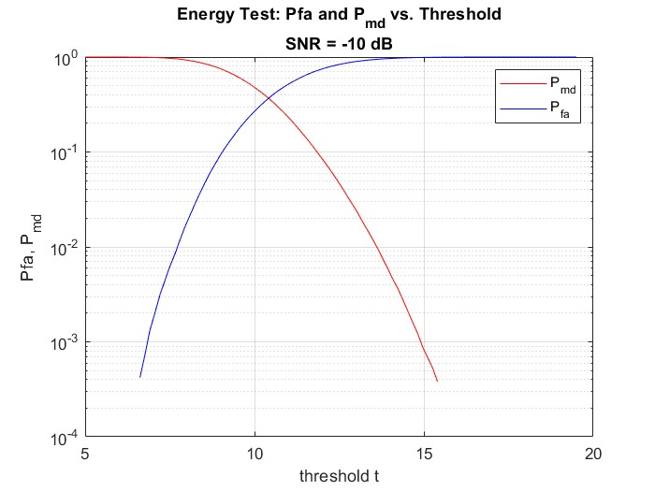
Energy test

Slide 19
ROC COMPARISON
The graphs look different because we're using two different ways to check for the alarm signal. One way looks at how similar the signals are over time, while the other focuses more on the total power of the signal.
Considering our scenario, the correlation method might be preferable if we anticipate clear patterns in the signals.

